Slide 1

Safeguarding Updates
Spring Term 2026
Notes:
WELCOME to the Early Years Service Safeguarding Updates for the Spring Term.
We are making termly Safeguarding Updates available for all to view on the safeguarding pages of the early years web. We invite input from our colleagues in LADO and MASH and are interested to hear of any subjects you would like covered in future updates. There is a short feedback form for you to complete at the end of the presentation.

Slide 2
Current Trends
Autumn 2025 (1st September – 31st December)
 | Type of risk | Number of referrals received
1 | Domestic Violence | 13
2 | Domestic Abuse | 12
3 = = | Physical Abuse Unexplained Injuries Parent Criminal Activity | 6 6 6
Notes:
Each time a referral is made to First Response it is triaged and if it meets threshold, the MASH team asks services such as Early Years, ESAS and health for information they may have in relation to a child in the family.
If a child in the family is known to attend a setting the team contacts the DSL and either gathers information t submit to MASH or requests their attendance at the Strategy Meeting.
Each term we will be sharing the top three categories of concerns received by the team in relation to referrals.
Providing this information raises awareness of what is happening across the county and supports you when considering training for yourself and your teams and what information sharing the families you support may benefit from
.

Slide 3
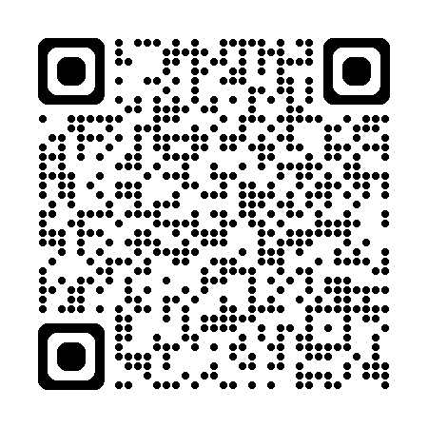
Spotlight on Safer Recruitment
References must be obtained before employment commences
Don’t accept applicant‑provided, character‑only, or open “To whom it may concern” references
Must come from current employer/
training/education; signed by senior person; verify source
Check & clarify vague info, cross‑check dates, confirm reason for leaving
References should be provided, for previous employees, upon request in a timely manner
Applies to staff, students, volunteers, family
For students/gaps, use training/education refs; if no children’s work history, record reason & gain character refs
Update policy to include suitability checks for all recruits
Buckinghamshire Safer Recruitment Webinar
Notes:
Early years Providers must ensure that people being recruited to look after children are suitable to do so. Your checks must include verifying they have the relevant qualifications, training and have passed any vetting checks to fulfil their roles. you must record all the checks you have completed within the recruitment process which includes information about the staff qualifications, identity checks, vetting processes for example their DBS details and that all the references have been obtained.
1. Within the safer recruitment requirements there are new expectations to obtain references before the employment commences but also requirements to provide references. The requirements on safer recruitment and whistleblowing apply to childminders with assistants however are not relevant to lone-working childminders who have no staff . It is not possible to obtain/provide references with no staff and to expect a lone childminder to create staff policies for individuals who don't exist would be burdensome and would not enhance children's safety.
You can find more information about safer recruitment on the safeguarding pages of the early years web, alternatively we recommend whoever is responsible for recruitment in your organisation attend safer recruitment training. You can find details of upcoming webinars on the Early Years training calendar.

Slide 4
LADO Updates
100 contacts from the EY sector this academic year
Key themes:
DfE Guidance needs to be followed
Ensure Whistle-blowing routes include internal and external options
Good, timely and consistent recording is useful for the child and staff
Risk assessments (including dietary restrictions) are there for a purpose. Follow them
Notes:
Since Sept 2025 100 contacts have been made to LADo from eys providers 72 haven't met threshold.
Key themes. Allegations being made following practitioners not referring safeguarding concerns to MASH because they were worried what parents may say
Whistle-blowing reports which uncover months of unreported concerns,. The WB policy should have both internal and external routes for staff to escalate concerns (EYFS 3.7&3.8) The external route can include the LADO where the behaviours harm or put a child at risk. Please refer teo the sfaeguardign reforms presentation on this webpage for more detailed information.
Using accident records, nappy changing records, physical intervention reports and recording of incidents in line with your settubg policy and completed in a timely manner. These have all be used to provide supporting evidence in allegation investigations.
Ensuring actions are followed to safeguard children when Identified in risk assessments. If your risk assessment says a child is likely to run off, and they leave your premises, it becomes an allegation. If a child is allergic to eggs, and they are given eggs, it is an allegation. Risk assessments are working documents and are there for a reason, please use them.

Slide 5
Keeping Children Safe in Education (KCSIE)
The Department for Education is proposing changes to Keeping children safe in education.
The statutory guidance sets out:
what schools and colleges should do
the legal duties that they must comply with to keep children safe
Share your views here;
https://consult.education.gov.uk/independent-education-and-school-safeguarding-division/keeping-children-safe-in-education-2026-revisions/
Notes:
The DfE is asking for your input into proposed changes to the KCSIE
The consultation closes at 11:59pm on 22 April 2026

Slide 6
Children and young people's mental health
It's reported that 1 in 5 children experience mental health challenges.
Following on from mental health week we wanted to highlight support available for children, young people and their families across Buckinghamshire.
Health for Under 5s | For healthy, happy early years
Unmasking parenthood | Buckinghamshire Council
Start a chat - ChatHealth
Notes:
Following on from mental health week which took place in February, we wanted to raise awareness if sine if the services available to children, young people and adults should they require it.
The Health for Under 5's website covers important milestones in a child's development from Toddler behaviour to supporting children through relationship breakdown
In your role working with children, young people and families you will often notice when parents or carers are struggling. Unmasking parenthood shares information, advice and guidance to support parents wellbeing.
ChatHealth Is a confidential text messaging service that gives young people quick, easy access to expert health advice. You can text anonymously if you prefer, and you’ll receive a reply within 24 working hours (Monday–Friday, 9am–4pm, excluding bank holidays).
Text: 07312 263295

Slide 7
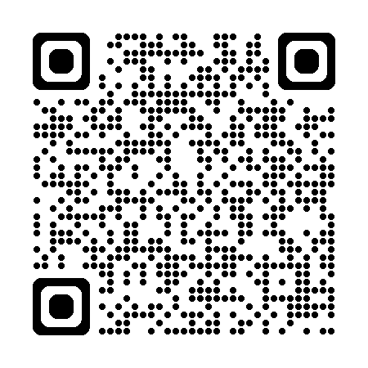
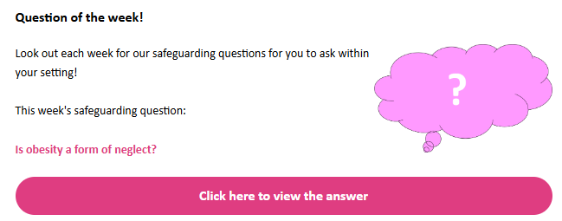
Sector Updates
Please subscribe (QR code):
Safeguarding articles
Question of the Week
New library for reference
Notes:
If you haven’t already, please subscribe to the Early Years Sector Updates which will be issued weekly and contains a varity of ariticles and information including Safeguarding articles and Question of the week

Slide 8
Changes to Safeguarding Guidance for Providers (After-school clubs, Community activities and Tuition)
Updated Guidance for Self-Employed Providers
Following regulatory changes in 2026, individuals who are self-employed and undertaking regulated activity, can now apply for an Enhanced with Barred Lists DBS check on their own behalf.
However, where there is a contracting organisation, for example, a school, local authority or agency, or an appropriate umbrella organisation, the individual can still ask the organisation to make suitability decision on them, as they do now. To support that suitability decision, the organisation can submit the check application on the individual’s behalf.
Updated Information for Volunteers
For volunteers, the type of check will depend on the activity and setting they’re volunteering in.
If their role is eligible for a Standard, Enhanced, or Enhanced with Barred List check, the checks on your behalf guidance for volunteers explain how to apply for the appropriate check.
Notes:
This guidance applies to all out-of-school settings, such as before- and after-school clubs and holiday clubs plus community activities and tuition organisations It includes the information on polices and procedures that should be in place for these providers.
This document was updated at the beginning of February with Updated Guidance for Self-Employed Providers.
Following regulatory changes in 2026, individuals who are self-employed and undertaking regulated activity, can now apply for an Enhanced with Barred Lists DBS check on their own behalf.
However, where there is a contracting organisation, for example, a school, local authority or agency, or an appropriate umbrella organisation, the individual can still ask the organisation to make suitability decision on them, as they do now. To support that suitability decision, the organisation can submit the check application on the individual’s behalf.
Updated Information for Volunteers
For volunteers, the type of check will depend on the activity and setting they’re volunteering in.
If their role is eligible for a Standard, Enhanced, or Enhanced with Barred List check, the checks on your behalf guidance for volunteers explain how to apply for the appropriate check.

Slide 9


Contact Details
Concerned about a child?
If there is immediate risk of harm to a child, call the POLICE on 999.
For any concerns about a child, including foster placements, notification of offenders in area etc. please contact:
First Response team within Children’s Social Care:
01296 383962 (option 5)
0800 999 7677 (out-of-hours)
securecypfirstresponse@buckinghamshire.gov.uk
Concerned about a member of staff?
Allegations against people in a position of trust working in Buckinghamshire with children must be reported to the LADO as soon as possible and in all cases within 1 working day​
Contacts:​
LADO 01296 382070​
EYS 01296 387111​ (option 3)
Ofsted 0300 123 4666

Slide 10
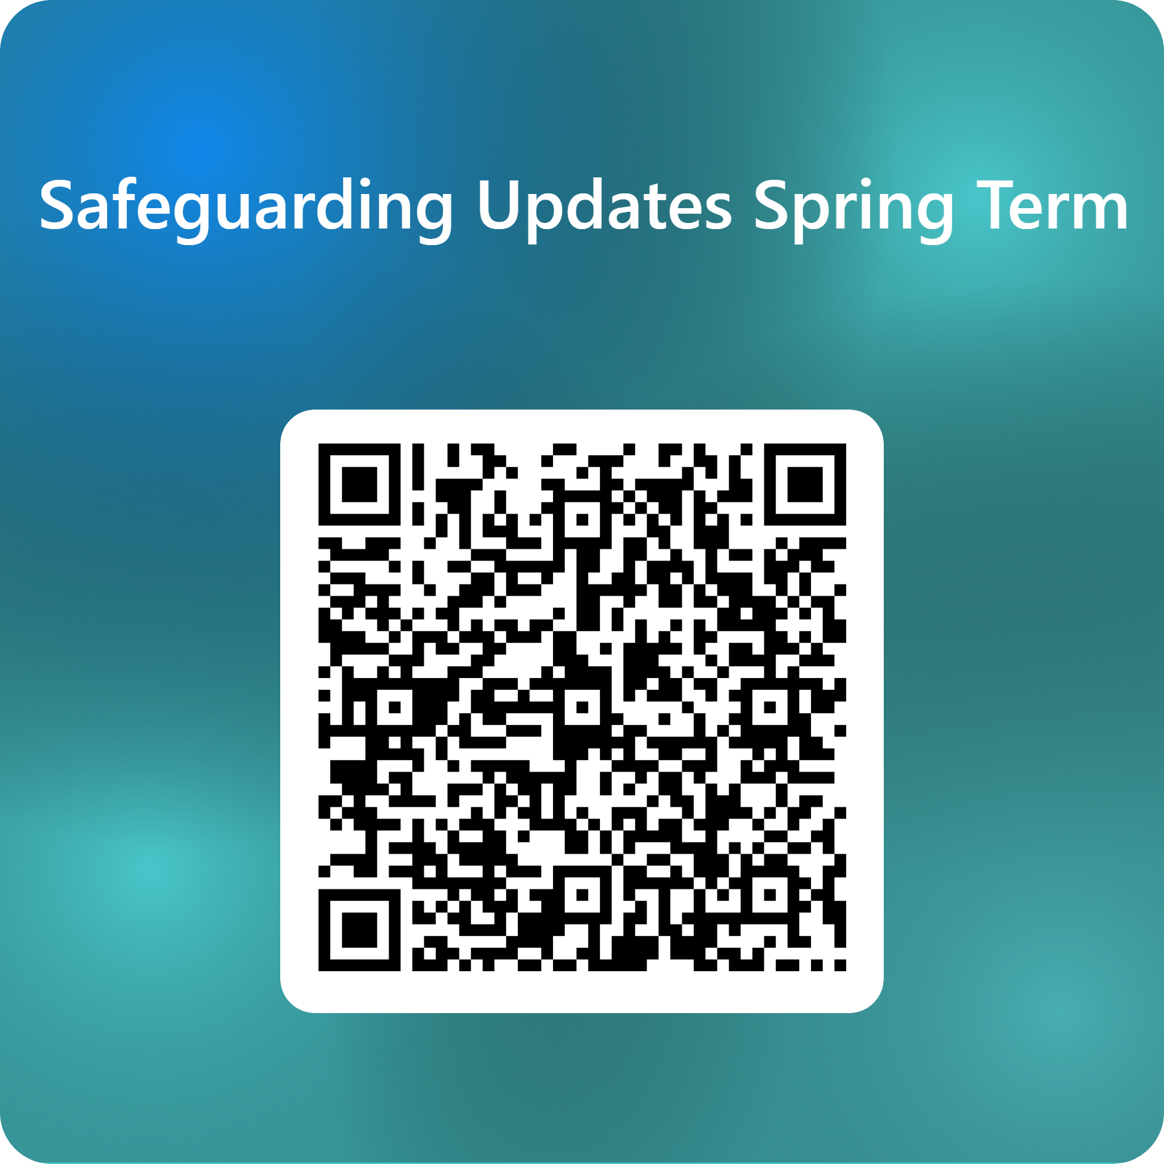
Please take a few minutes to feedback

